Slide 1

Lab 3: Python Time Series Data Visualizations
Time Series Visualization of Microsoft (MSFT) Stock – 2020
Data Analytics
IDC4252C-2032
Karah Culley

Slide 2

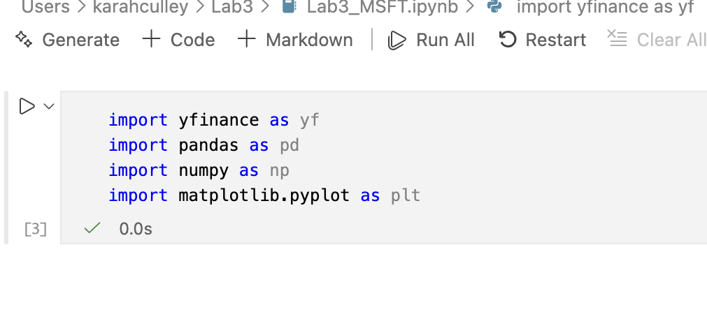
Importing required libraries
In this step, I imported the required Python libraries for financial data analysis and visualization.
yfinance was used to download stock data
pandas and numpy were used for data manipulation
matplotlib was used to create the time series plots

Slide 3
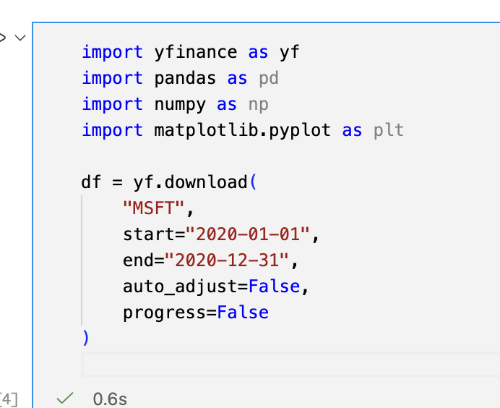
Downloading Microsoft Stock Data
I downloaded Microsoft (MSFT) stock data for the year 2020 using the yfinance library
The dataset includes daily stock prices (Open, High, Low, Close, and Adjusted Close)

Slide 4

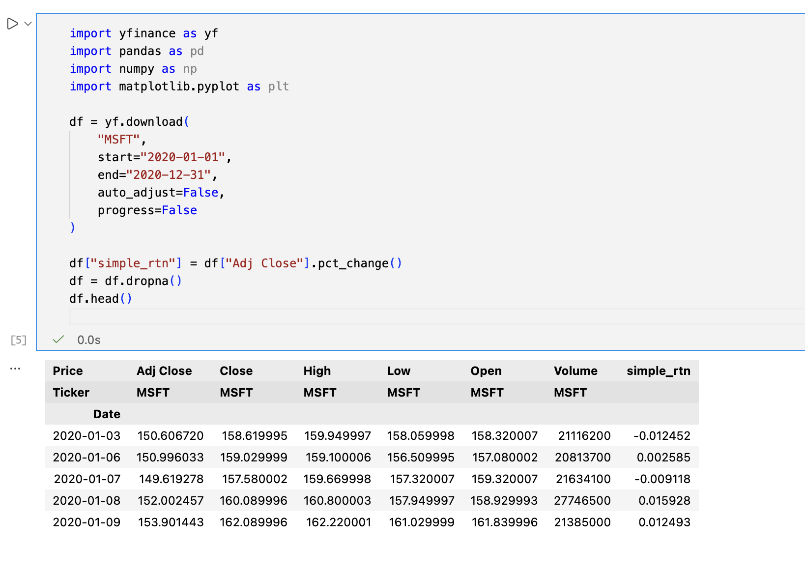
Calculating Returns
I calculated the daily simple returns using the percentage change of the Adjusted Close price
This measures the daily rate of return and helps analyze volatility and performance over time
Any missing values were removed using dropna()

Slide 5
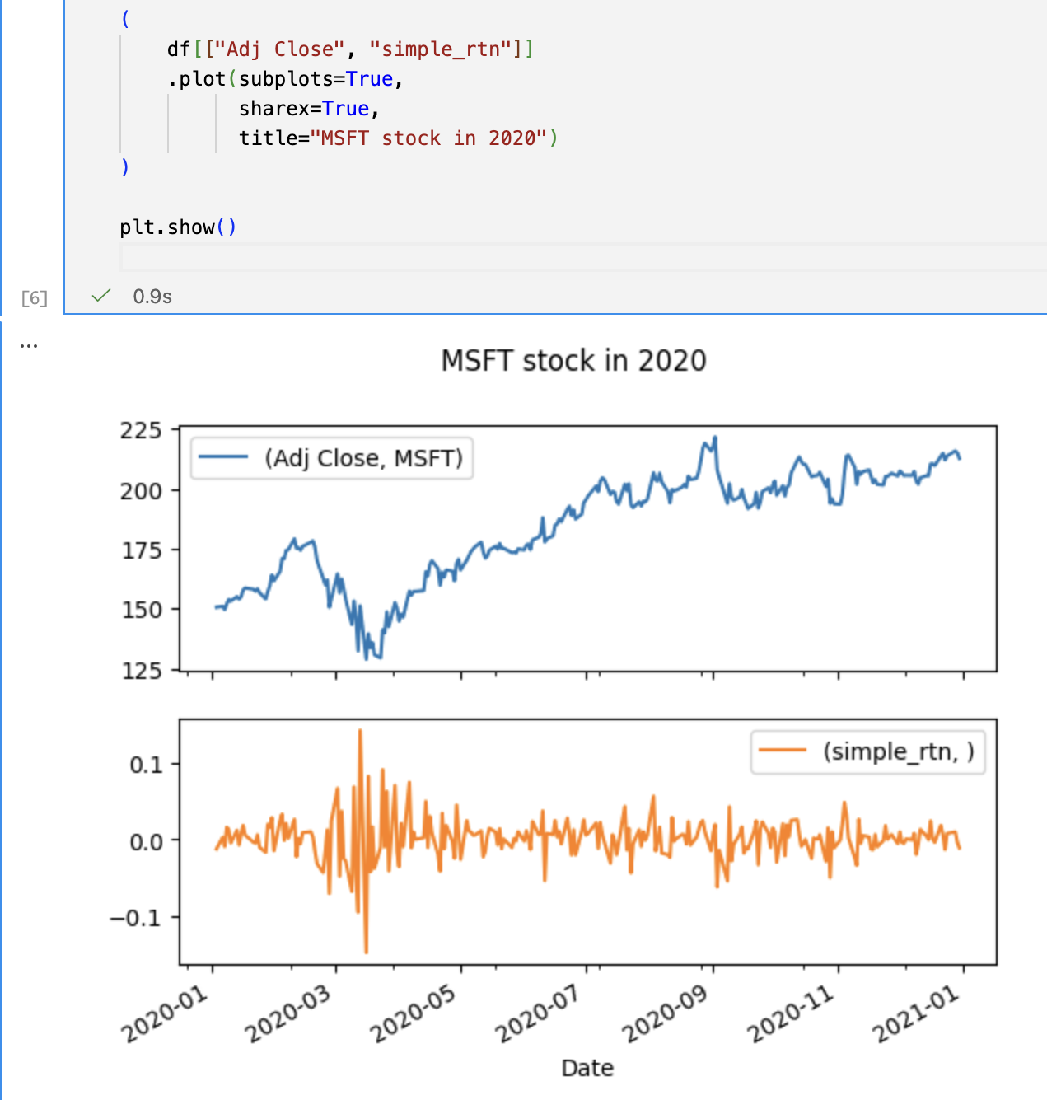
Basic Time Series Visualization
This plot shows Microsoft's adjusted stock price and daily returns for 2020
The top chart displays the price trend over time
The bottom chart shows daily simple returns, highlighting volatility during the year

Slide 6

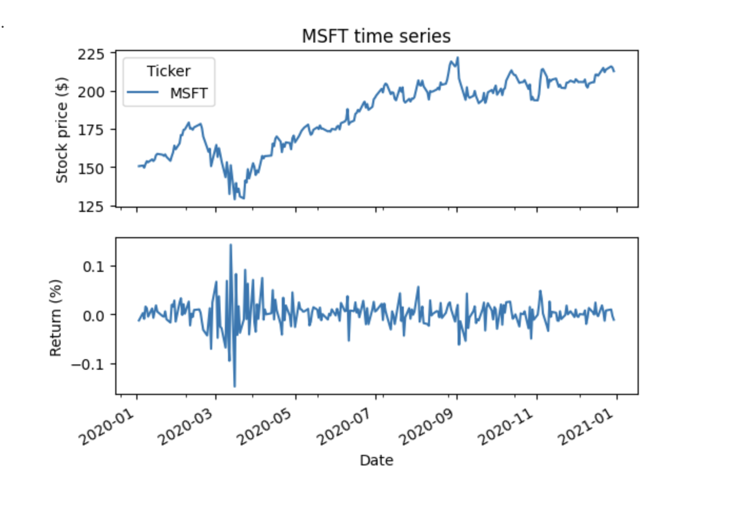
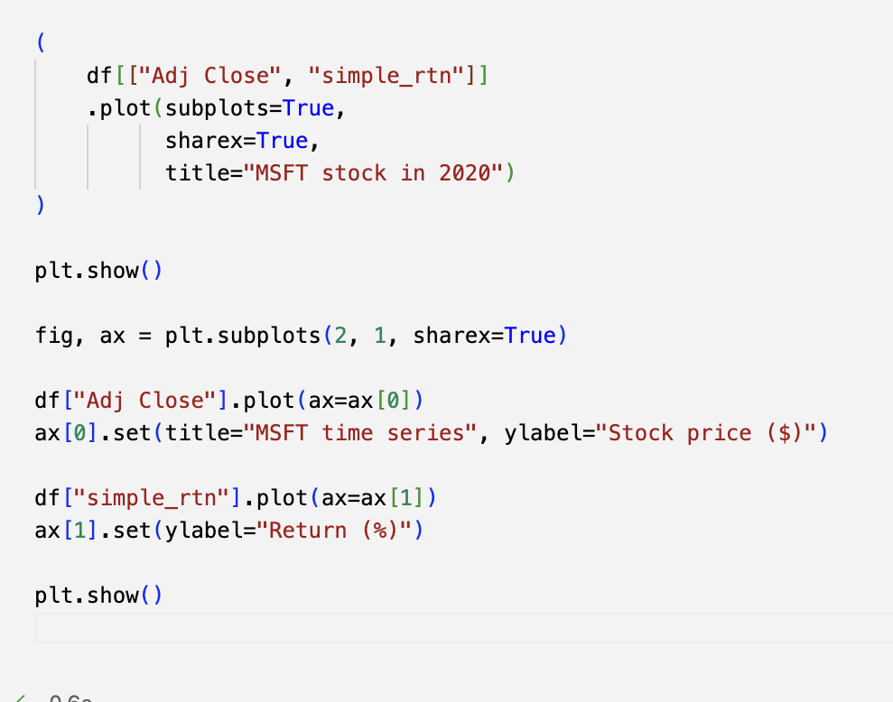
Object-Oriented Visualization
This figure recreates the object-oriented plotting approach from the Python for Finance Cookbook
The stock price shows an overall upward trend during 2020
The return series demonstrates higher volatility during market uncertainty, particularly early in the year
The code used and the diagram:

Slide 7
Thank you for your time Dr. Ahmeti ☺

